Slide 1
E-WASTE MANAGEMENT SYSTEM
Silvia Miriti Kajuju Registration Number: 189803
Shuku Verity Atoko Registration Number: 189593
Unit: IT Project 1
Supervisor: Jude Mido

Slide 2
Problem
Electronic waste is growing rapidly with people disposing their phones, computers, batteries and other electronics inappropriately. Many people lack the knowledge on how to dispose of electronic waste responsibly, contributing to pollution.
Proposed solution
A centralized E-Waste Management System will streamline the collection, tracking, and recycling of e-waste by connecting users, administrators, and recyclers through a single platform.

Slide 3
Requirements Table
E-waste disposal Functional requirements (1).xlsx

Slide 4
System design diagrams
This project follows the SSAD approach, and UML diagrams from OOAD are used to model and design the system. The SSAD approach is reflected through :
database system schema
wireframes
while the OOAD approach is represented using
use case diagram
class diagram
Entity Relationship Diagram (ERD)
shown from next slide

Slide 5
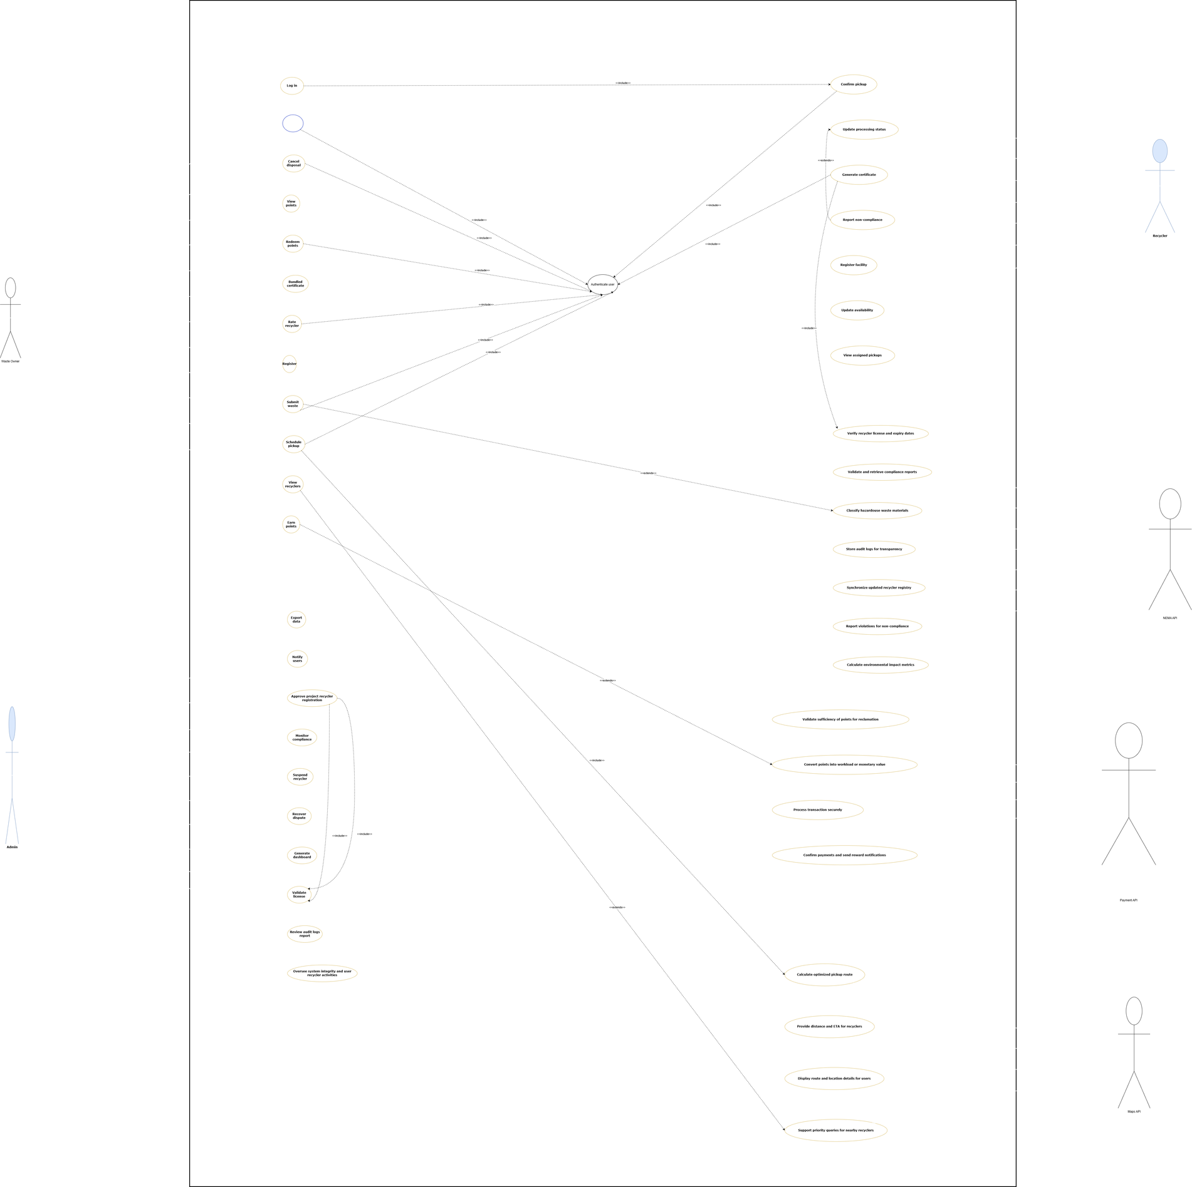
Use Case Diagram
Shows the interaction between users and the system and the main system functions.

Slide 6
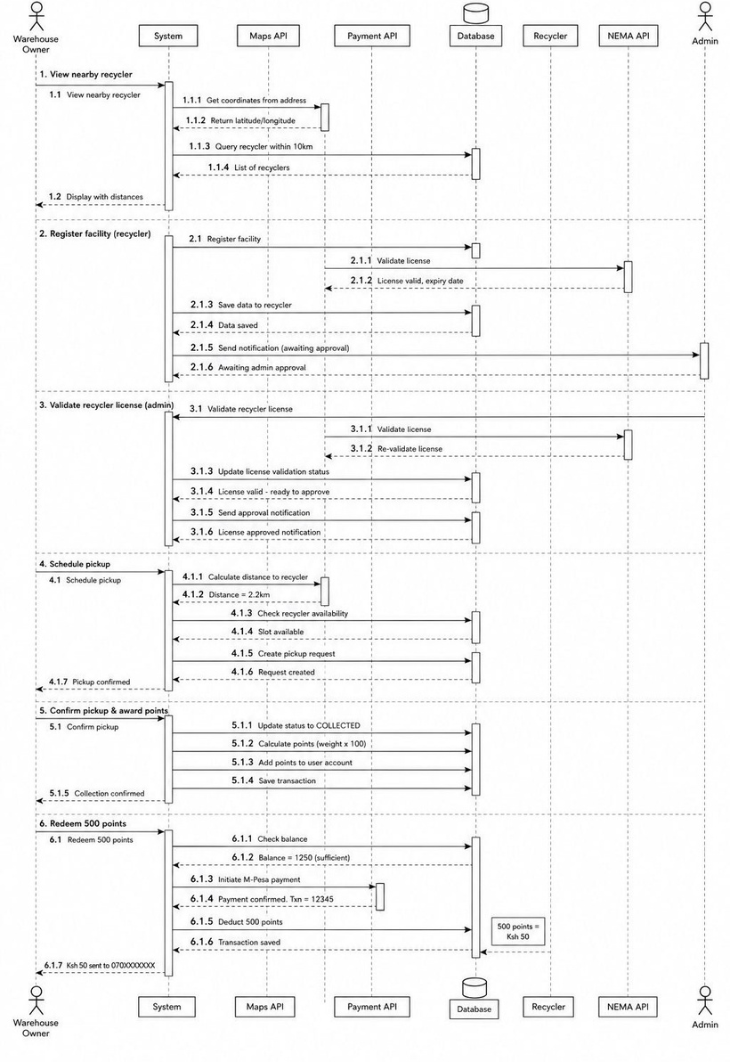
Sequence Diagram
Shows how processes interact in order over time between users, the system, and the database.

Slide 7
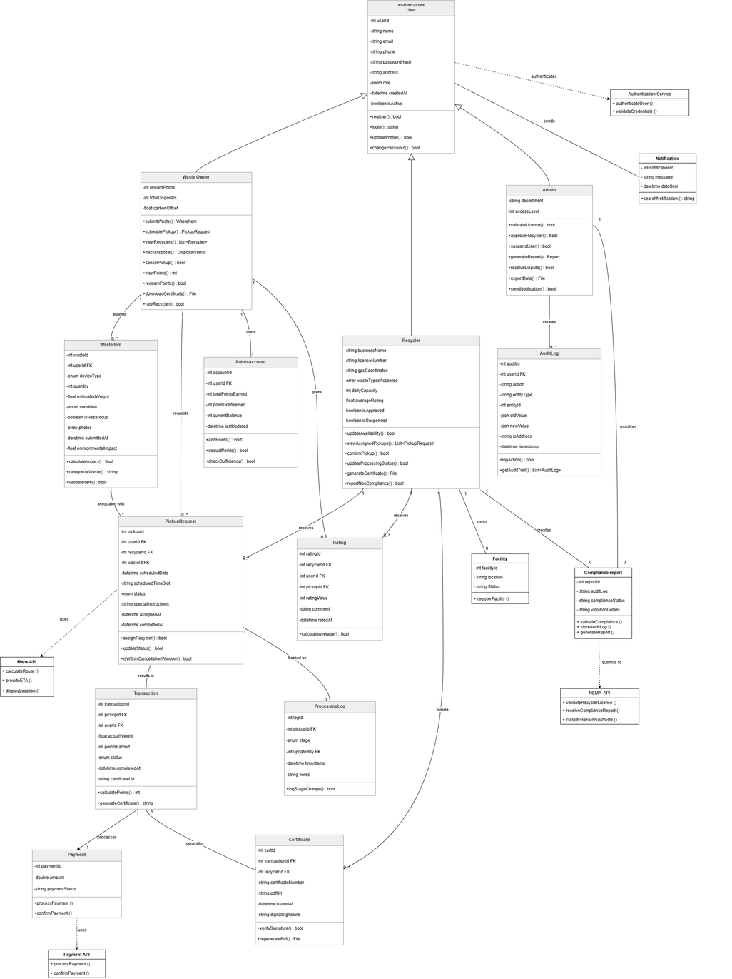
Class Diagram
Shows the system structure using classes, attributes, and relationships

Slide 8
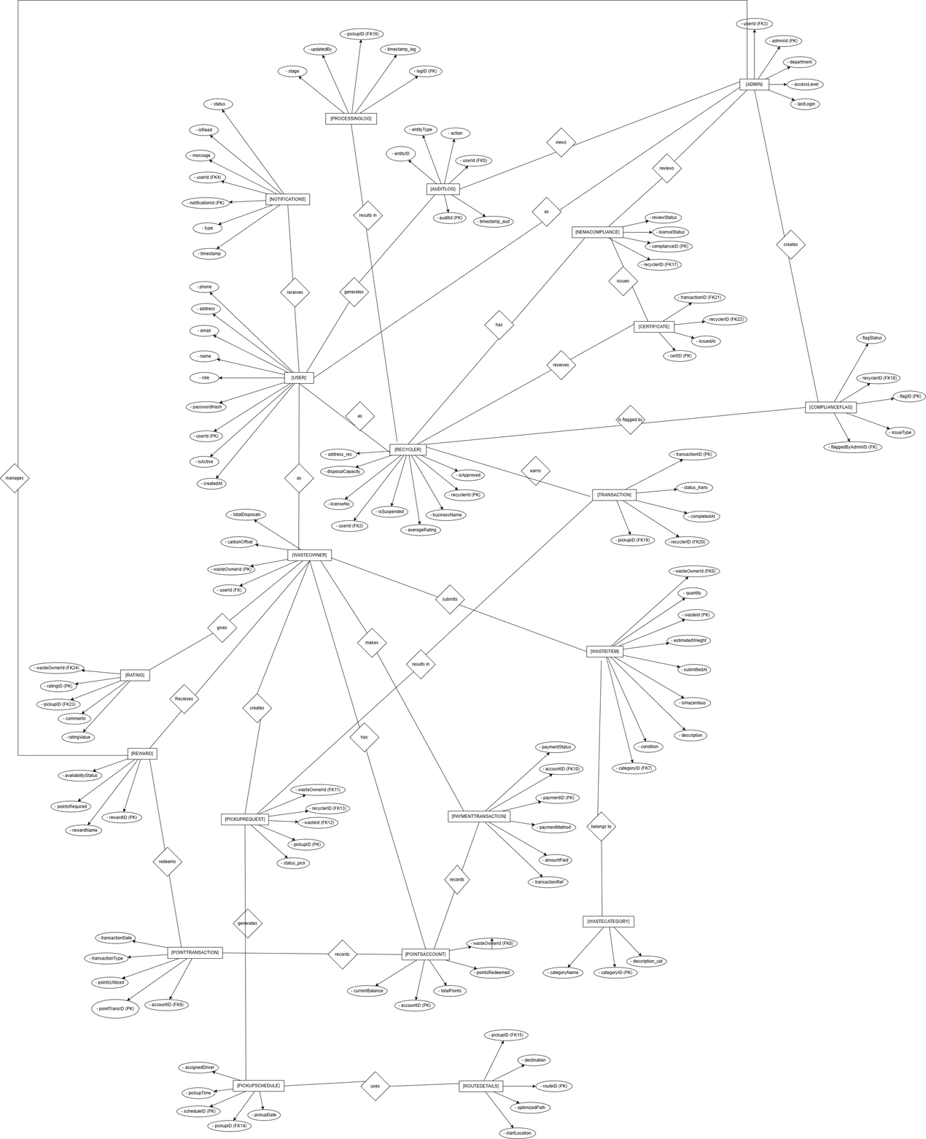
Entity Relationship Diagram(ERD)
Shows how data entities are related in the database.

Slide 9
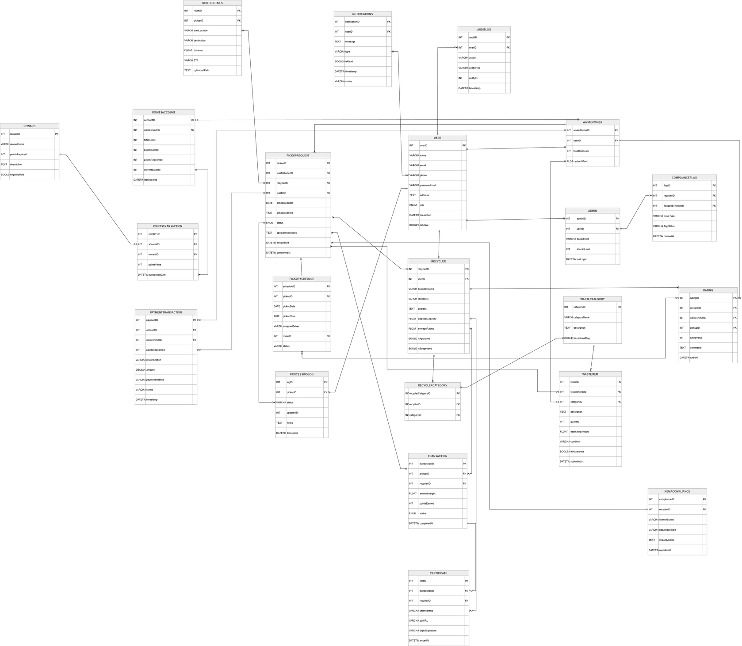
Database Schema
Shows the database tables and their structure.

Slide 10
Wireframes
Show the layout of key system screens including
admin dashboard
e-waste disposal dashboard
recycler finder dashboard
schedule pickup dashboard
showing from next slide

Slide 11
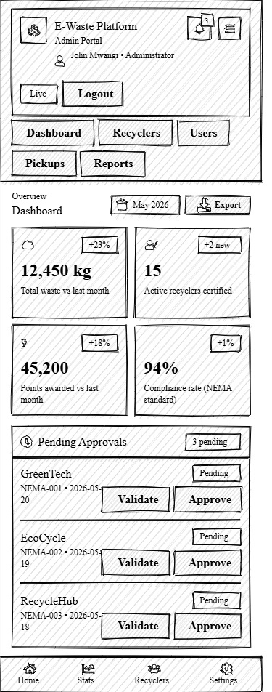
Admin Dashboard
Provides administrators with tools to manage users, monitor e-waste requests, approve pickups, and oversee system activities
continuation

Slide 12
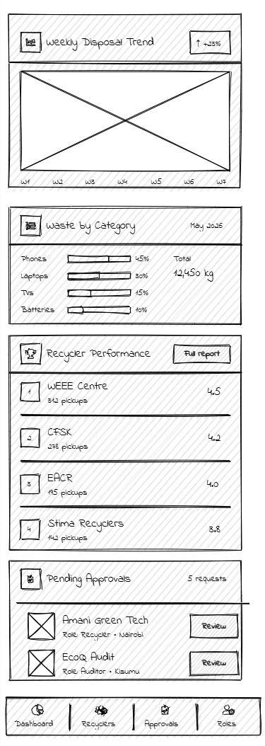

Slide 13
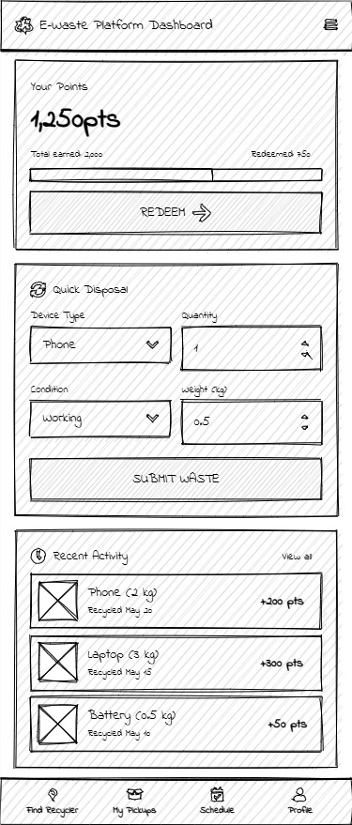
E-Waste Disposal Dashboard
Allows users to submit e-waste disposal requests and track the status of their submissions.

Slide 14
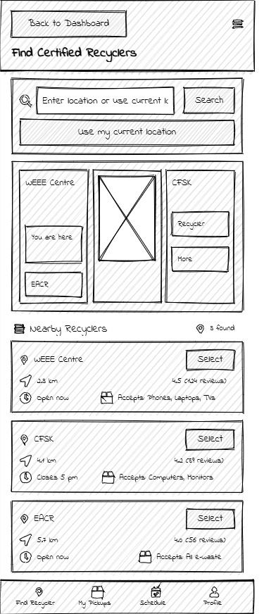
Find Recyclers Dashboard
Enables users to search for and view available e-waste recycling centers based on their location.

Slide 15
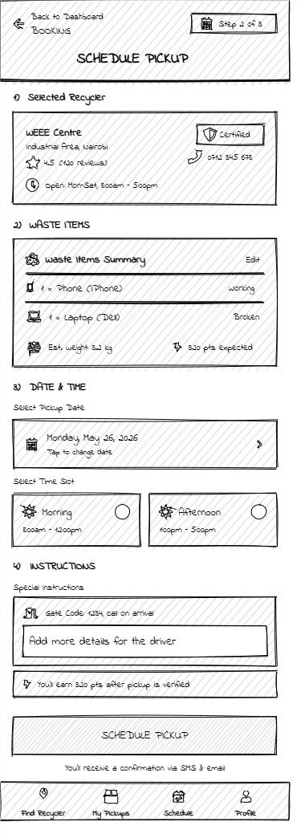
Schedule Pickup Dashboard
Allows users to schedule e-waste collection by selecting a preferred date, time, and pickup location

Slide 16
Thank You

